Slide 1

CASE STUDY
WELCOME ALL
Team name
BVK2T

Slide 2





Team Members :
TANISHA
KAVYA
VAISHNAVI
TEJASWINI
BHUMIKA

Slide 3




Introduction
From the various problems that are found around us in our day-to-day life we have chosen the one which stands upto our potential. We have tried our level best to use the steps of design thinking and deduce the solution

Slide 4

Design thinking Agenda
Empathise
Define
Ideate
Prototype
Test

Slide 5
STEPS IN DESIGN THINKING:
Every problem has a human element
DEFINE
What we are trying to solve
IDEATE
Think big all ideas are welcome
PROTOTYPE
TEST
Test its prototype get feedback fine tune
Develop a test model
EMPATHISE

Slide 6

Design thinking is the search for a magical balance between business and art; structure and chaos; intuition and logic; concept and execution; playfulness and formality; and control and empowerment.
-IDRIS MOOTEE

Slide 7
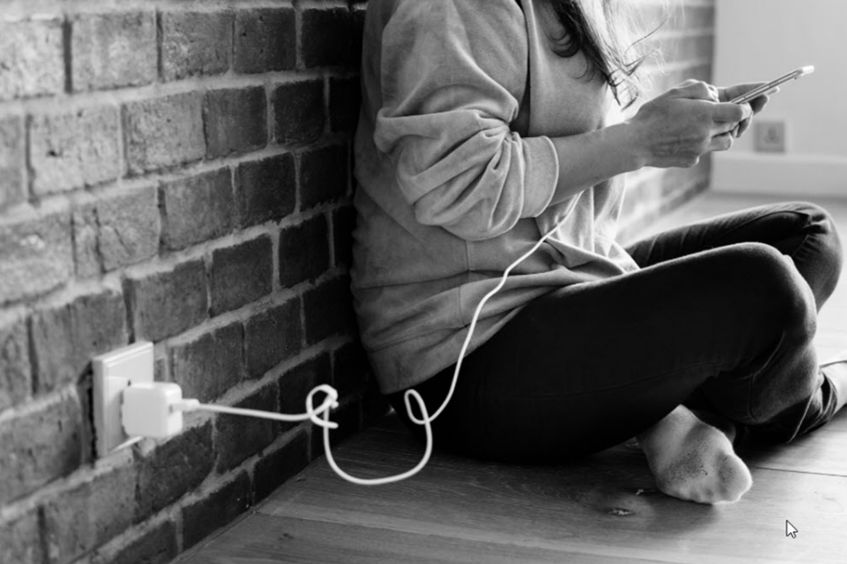
TOPIC:
Not using mobiles while charging

Slide 8
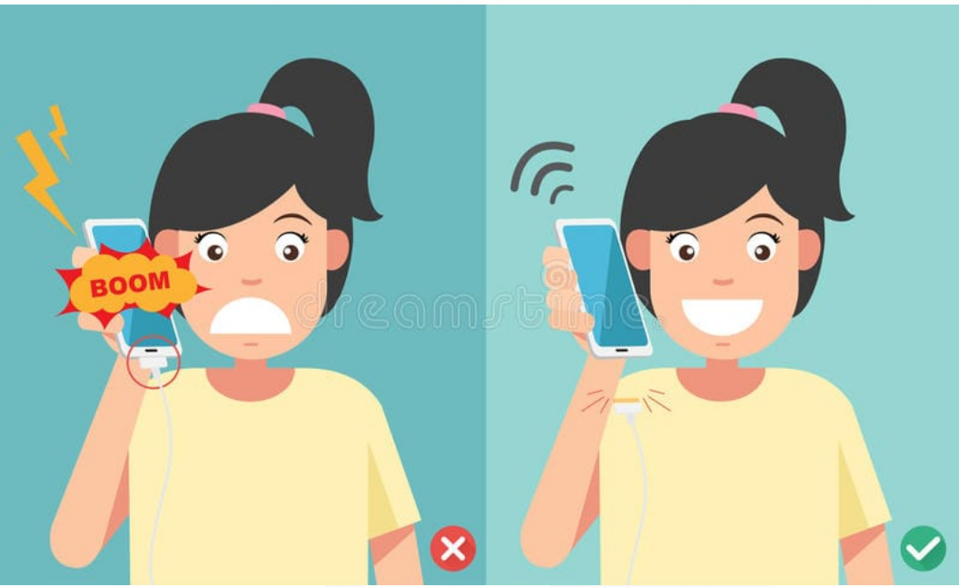
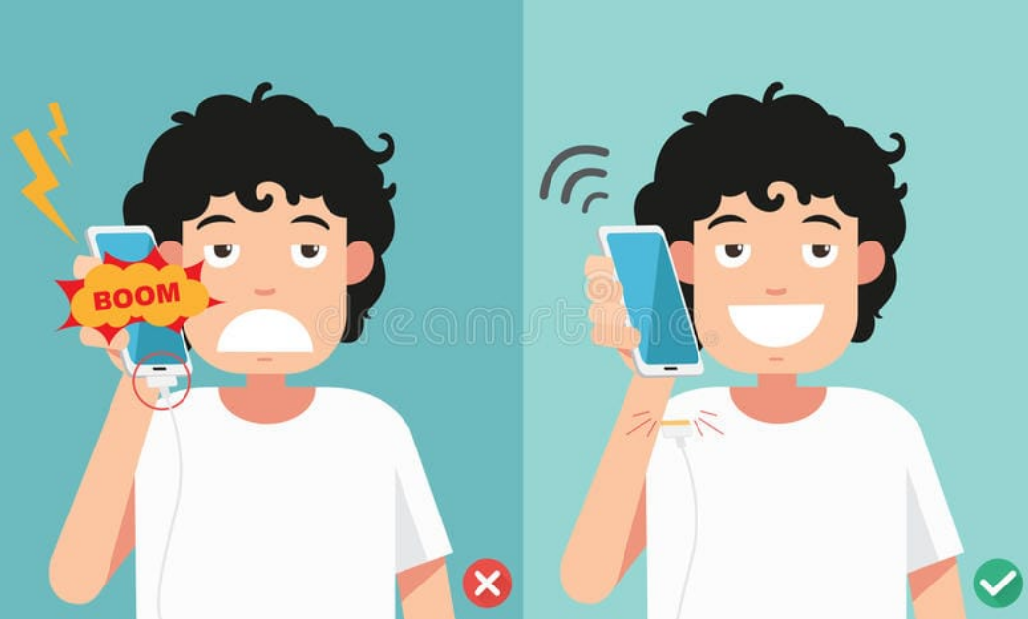
Mobile Blast while Charging in room - Must watch - YouTube

Slide 9

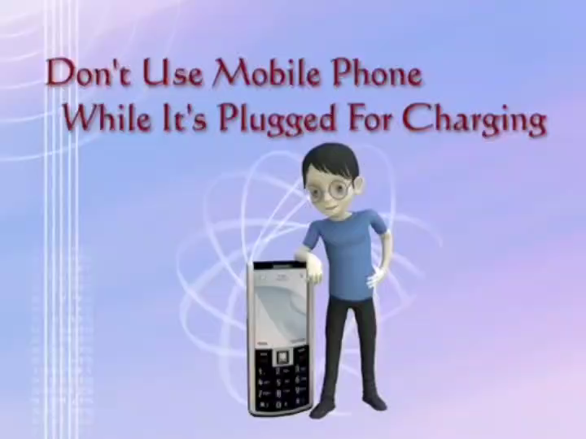
CAUTION

Slide 10

EXAMPLE:
17-year-old Shradha Desai dies as the mobile explodes while charging
-she is from Chetasan village (Gujarat)
-she was talking over the phone while it was being charged
- the mobile phone exploded and she was injured badly
-she was not able to overcome the severe injuries and she died..
SHRADHA DESAI

Slide 11
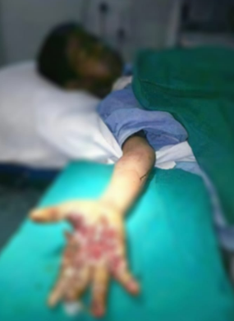
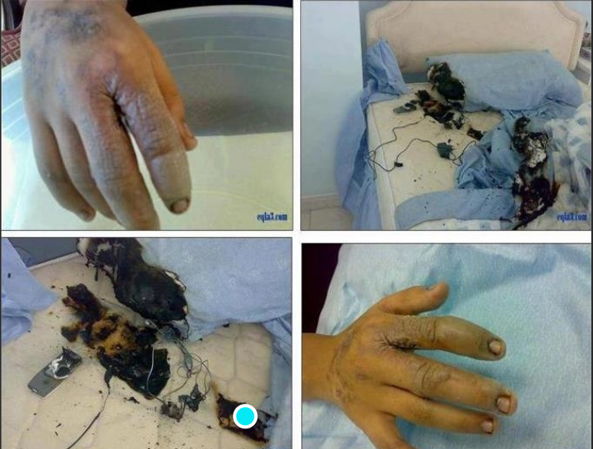
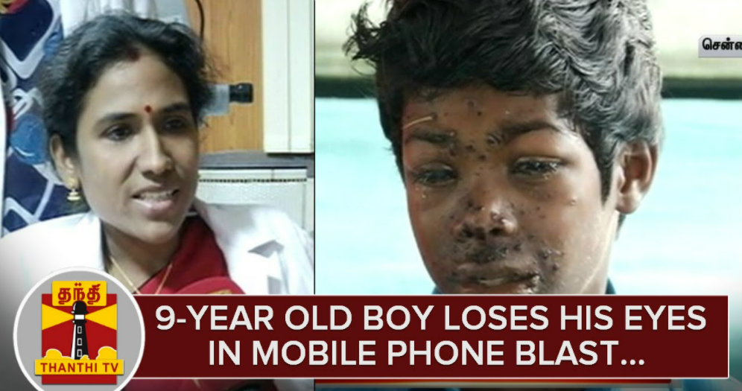

Slide 12


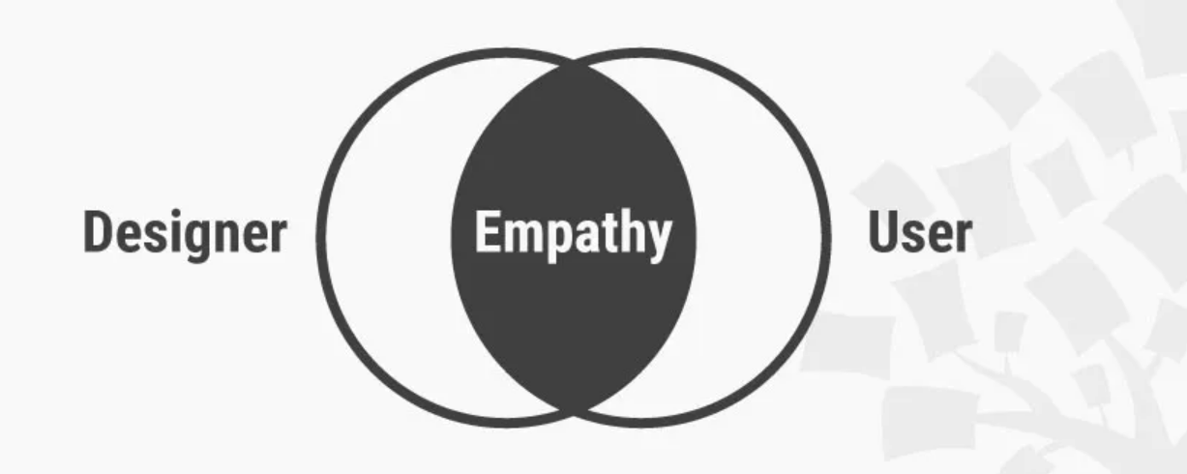
Step -1 EMPATHISE

Slide 13
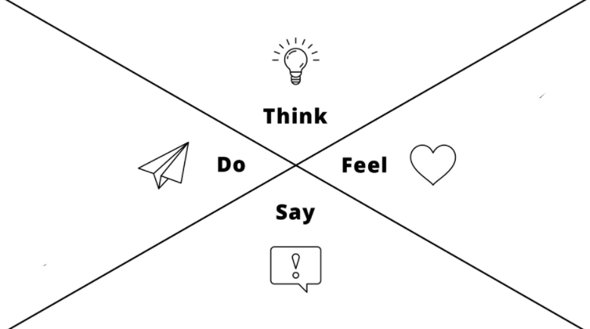
EMPATHY MAP :
Happens in a very few cases
It will not make any difference
Continue to work on phone while charging
Work is more important than anything

Slide 14



Step-2
DEFINE

Slide 15
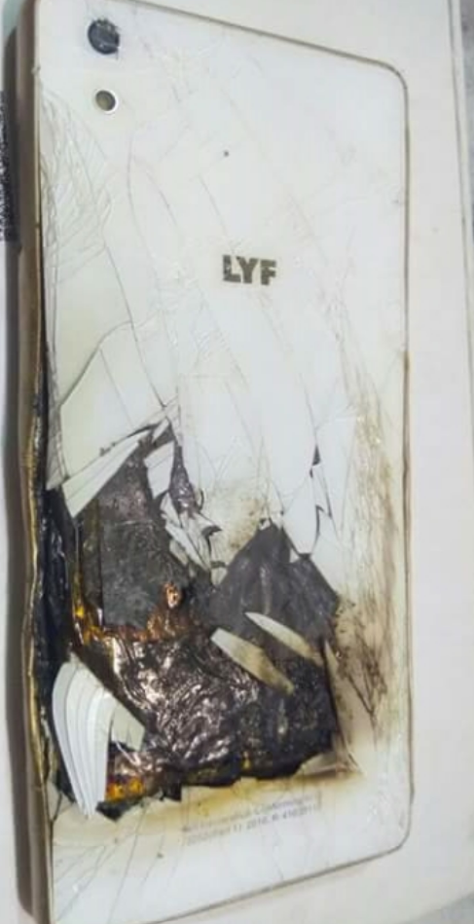
CHEMISTRY BEHIND BLASTING OF BATTERIES
When batteries are on charge hydrogen & oxygen are both evolved as gases. They do recombine to form water but not fully. If the hydrogen gas is evolved to such an extent that the concentration of hydrogen gas is greater than 4% it can cause an explosion of the battery.
The common cause of battery explosion is when it is recharged too much.
On the other hand, battery defects are the primary reason. when the battery overheats, apart from the damage or using third-party chargers. Chief among them is the overnight charging. Most of us have this habit of putting the phone on charging while going to sleep. This takes a toll on the battery as charging it excessively can result in overheating, overcharging, short-circuit, and at times, explosion. If we use mobile while charging
Now there's a specific time required for a battery to be fully charged, for example if its a 2000mAh battery then it'll need around 1 and a half hour to reach 100% if your not using it. If you are using it then it takes more time.
Now if the battery is charged for a longer duration at 1 go then it begins to bulge or grow in size. Once the battery swells then you'll gave many problems. It heats up the phone . In some cases the battery explodes and can cause severe damage

Slide 16
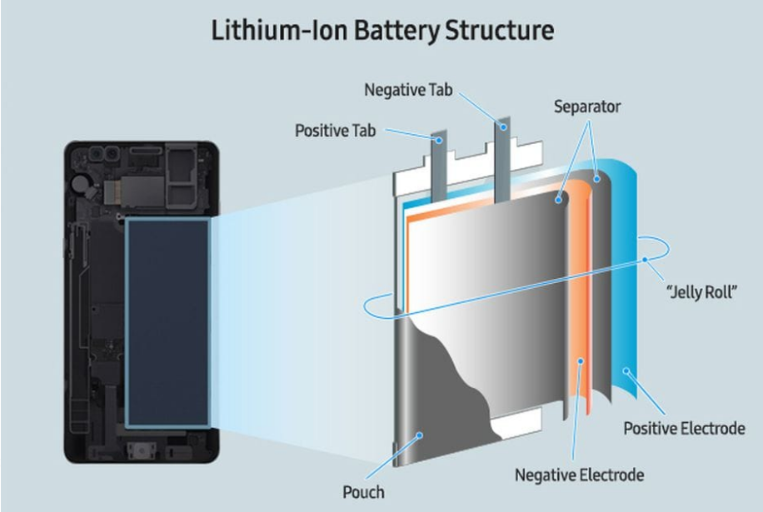
What Damage Does Overheating Do to Your Phone?
1.Battery Damage
Lithium-ion batteries are the best batteries on the market, but one of their drawbacks is that they become less effective over time. The hotter the temperature, the more quickly your battery will lose its ability to store energy efficiently . Hot temperatures can also cause long term damage to your battery.
2. Adhesive Damage
Extreme heat can also damage the adhesives that hold your phone together. These adhesives are responsible for bonding the components of your phone and helping to protect your device from water. When exposed to high temperatures, these adhesives can start to degrade, creating gaps or allowing components to shift. This could let more dust and dirt into your phone and increase the risk of water damage.

Slide 17
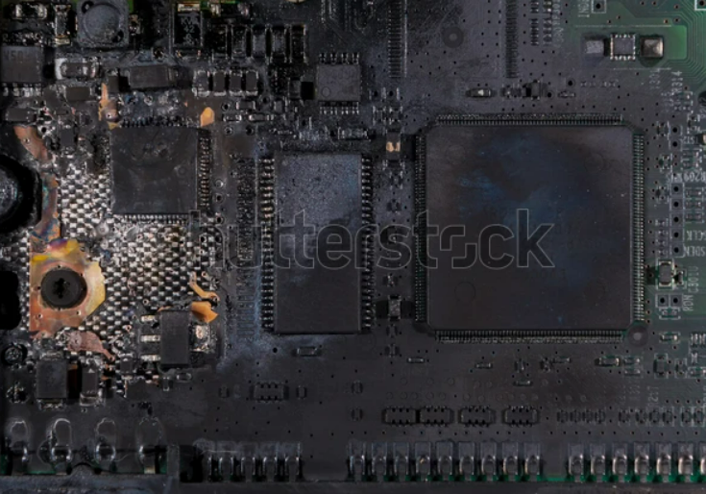
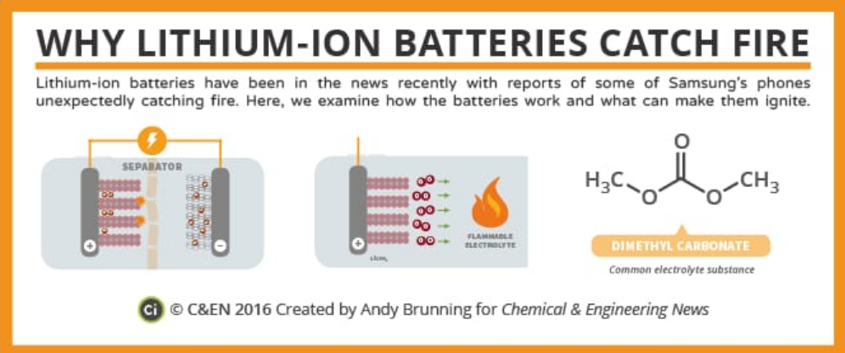
3. System on Chip Damage
Frequent overheating can also damage your CPU, GPU and other components housed in your system on chip (SOC), an integrated circuit that combines various components such as processors, memory, wireless network capabilities and on-chip caches. While these chips can withstand relatively high temperatures, over time, overheating can damage these chips. When these chips get damaged, they won't work as effectively, slowing down your whole phone. Frequent high temperatures can decrease the lifespan of your CPU, GPU and other chips

Slide 18


Step-3

Slide 19

Process of Ideating…
SIMPLE IDEAS
Charge the phone with its own charger
Never leave phone charging through out the night
Don’t cover your phone when its charging
Use reputable chargers

Slide 20

CRAZY IDEAS
Understand your phone’s mAh and charge accordingly put a timer and doze off!!
Develop an inbuilt software to turn of power supply when phone is in use
Estimate maximum time your phone takes to charge and set an alarm
Remember your mother’s angry face when your tempted to use

Slide 21
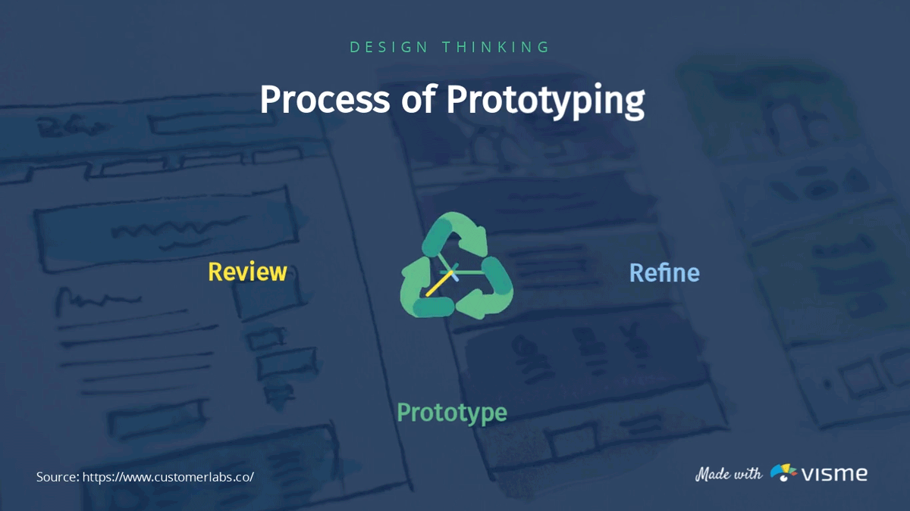
Step-4
PROTOTYPE

Slide 22
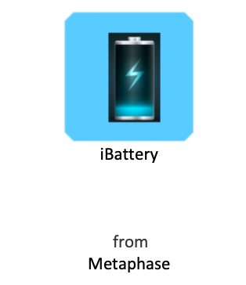
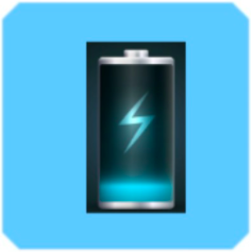
Here is the outlook of our app
App icon
iBattery

Slide 23

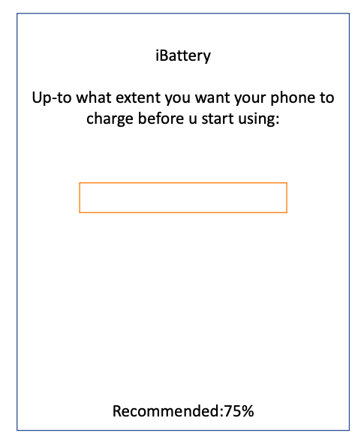



Sign in
Username
Mobile number
Phone model
Login
23

Slide 24
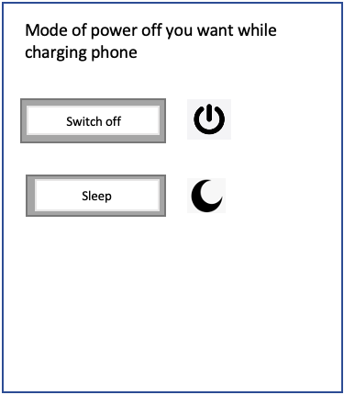
EC
Emergency calls
ET
Emergency text

Slide 25


Slide 26

Step-5
TEST

Slide 27

Method of testing….
GOOGLE FORM

Slide 28
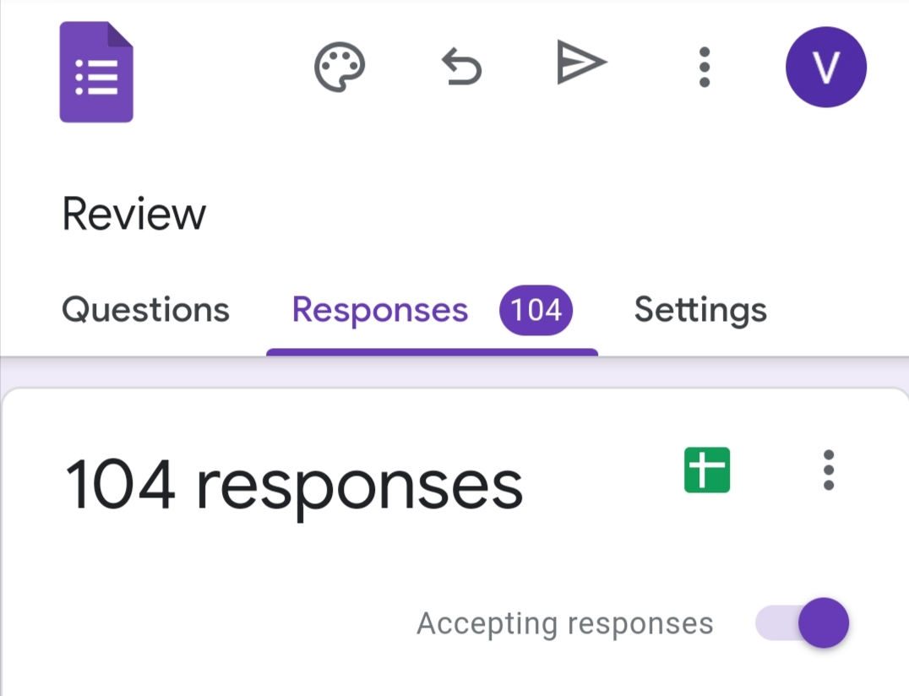
Our responses:
Total number of responses – 104

Slide 29
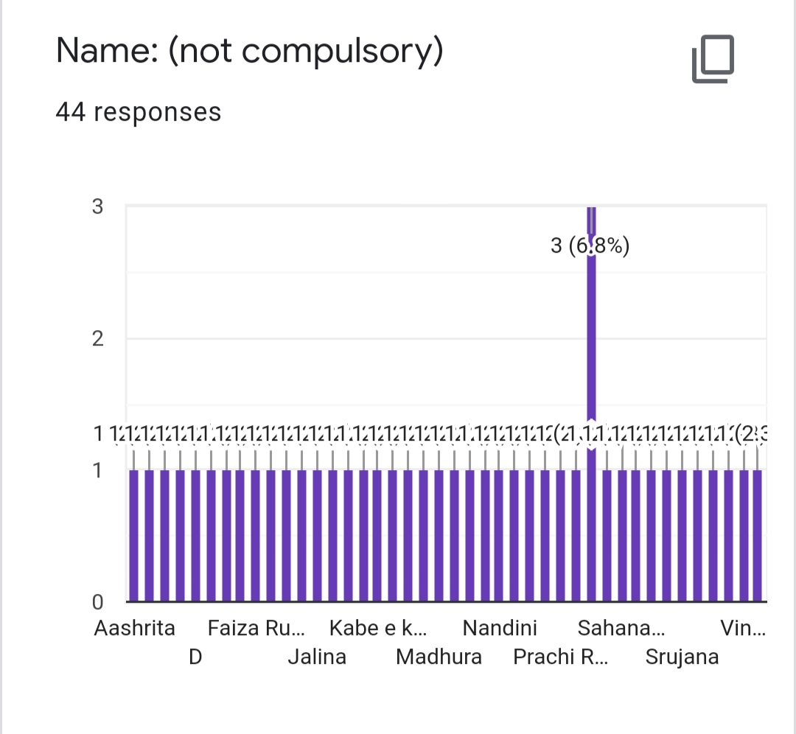
NAME OF THE PERSON

Slide 30
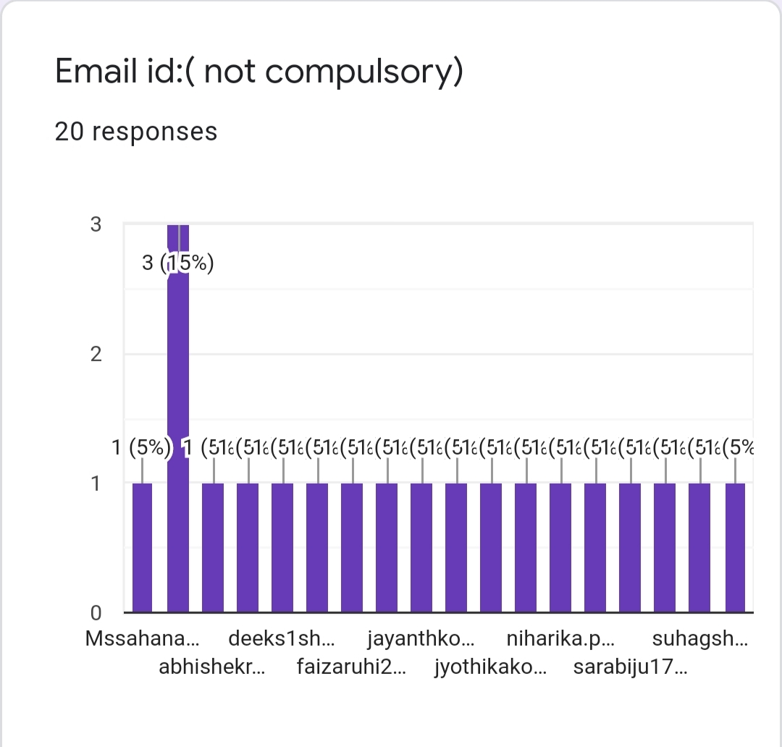
Email Id of the person

Slide 31
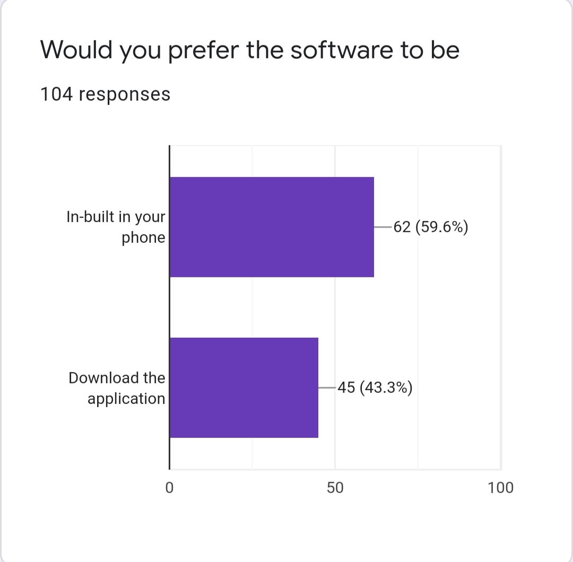
Would you prefer the software to be

Slide 32
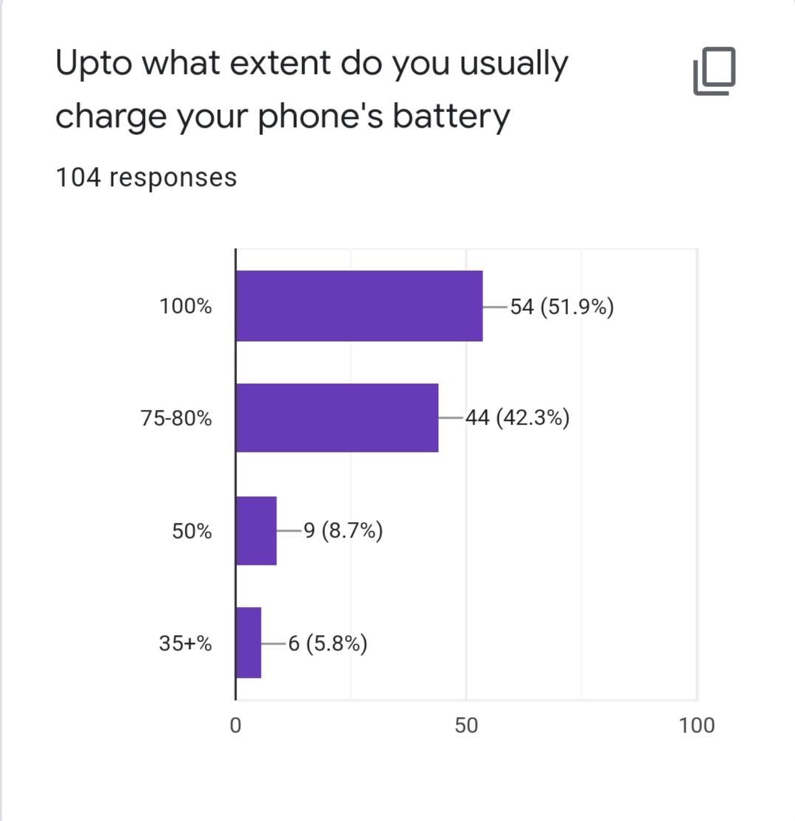
Up to what extent do you usually charge your phone’s battery

Slide 33
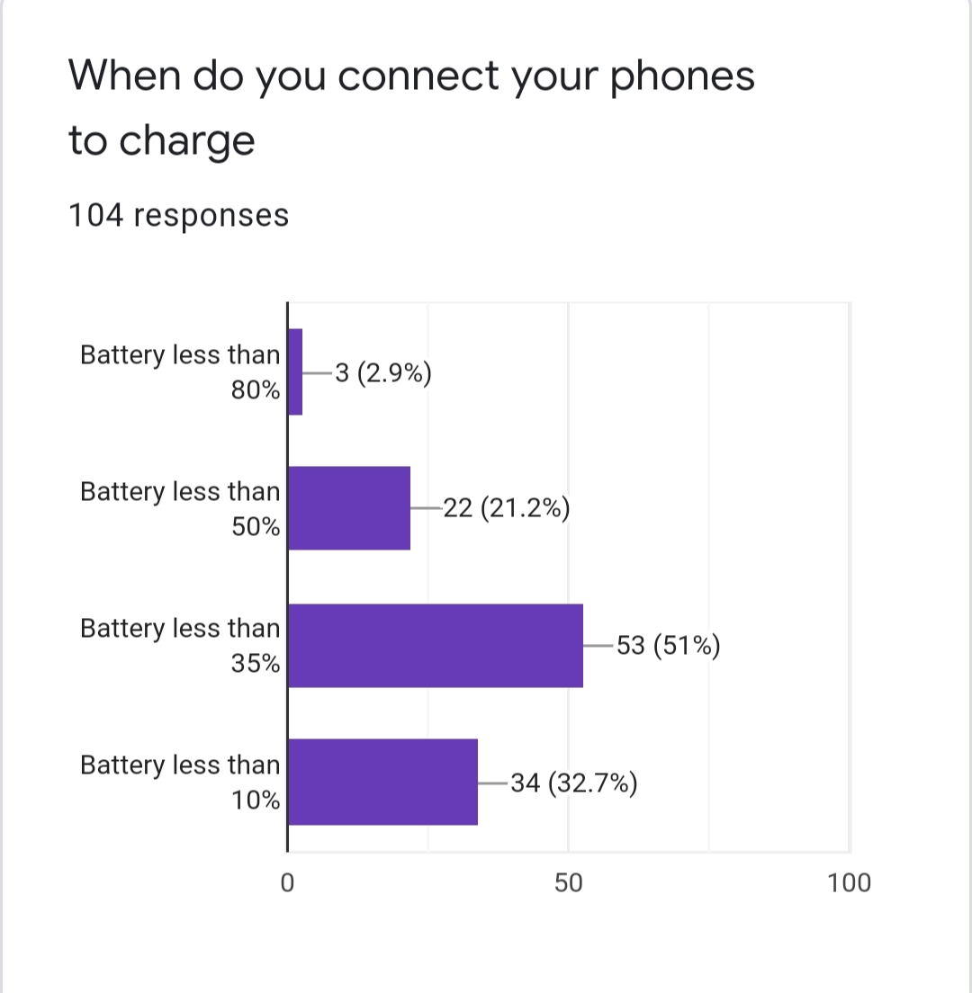
When do you connect your phones to charge

Slide 34
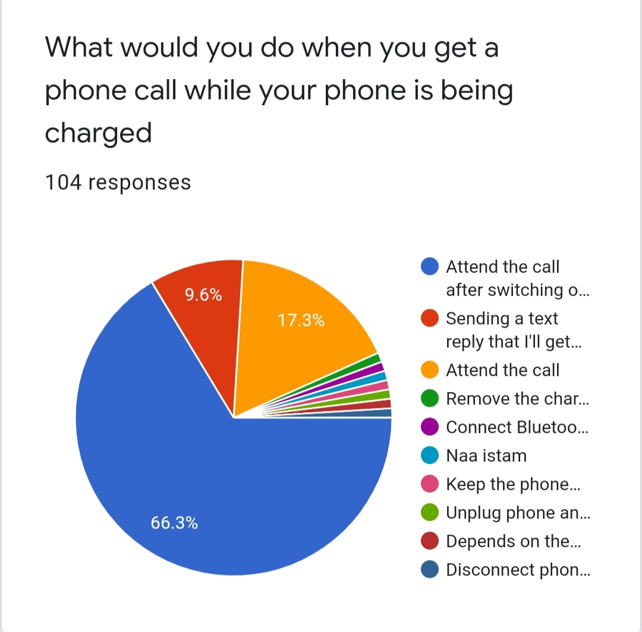
What would you do when you get a phone call while your phone is being charged

Slide 35
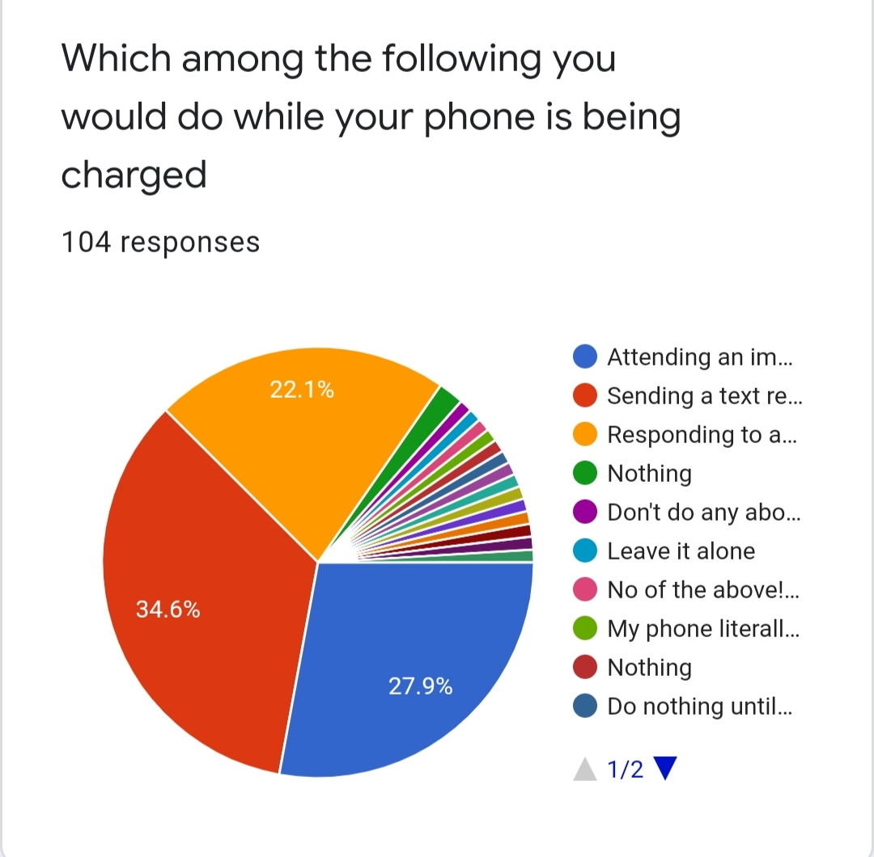
Which among the following you would do while phone is being charged

Slide 36
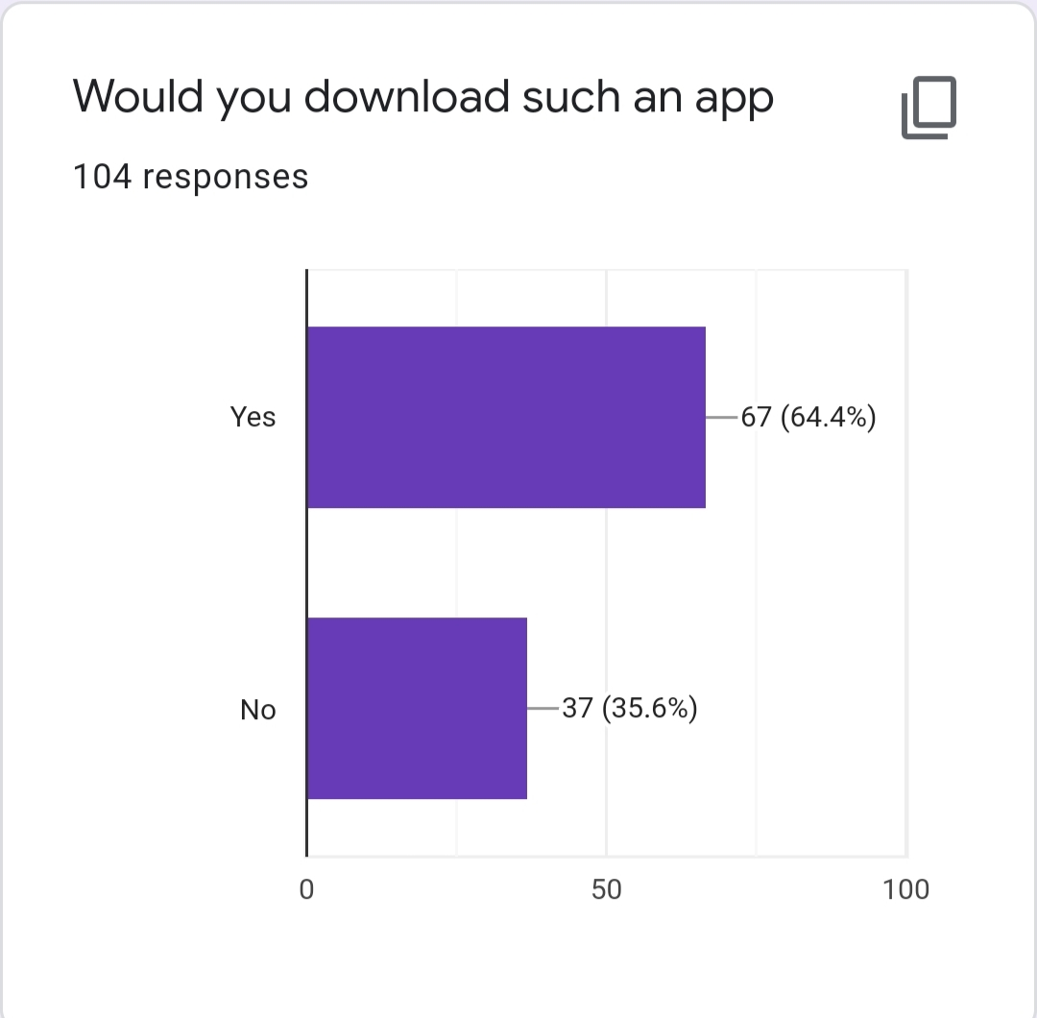
Would do download such an app

Slide 37
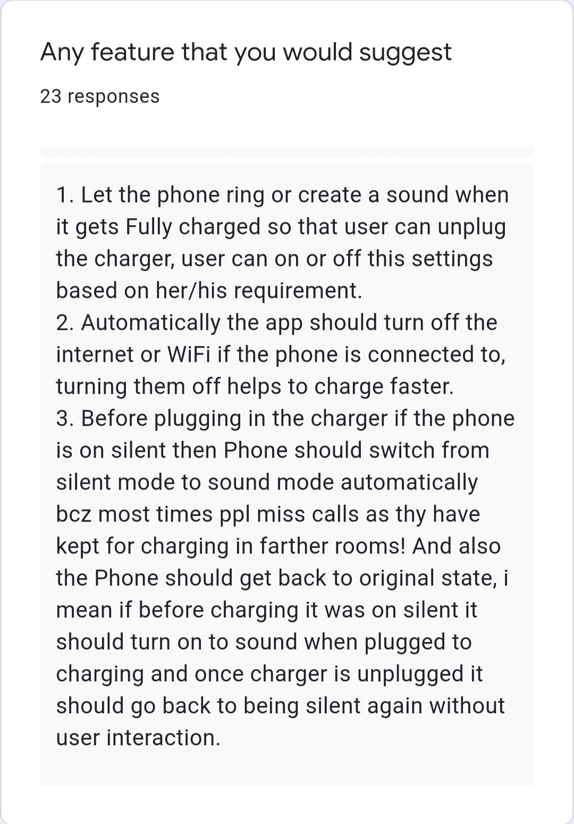
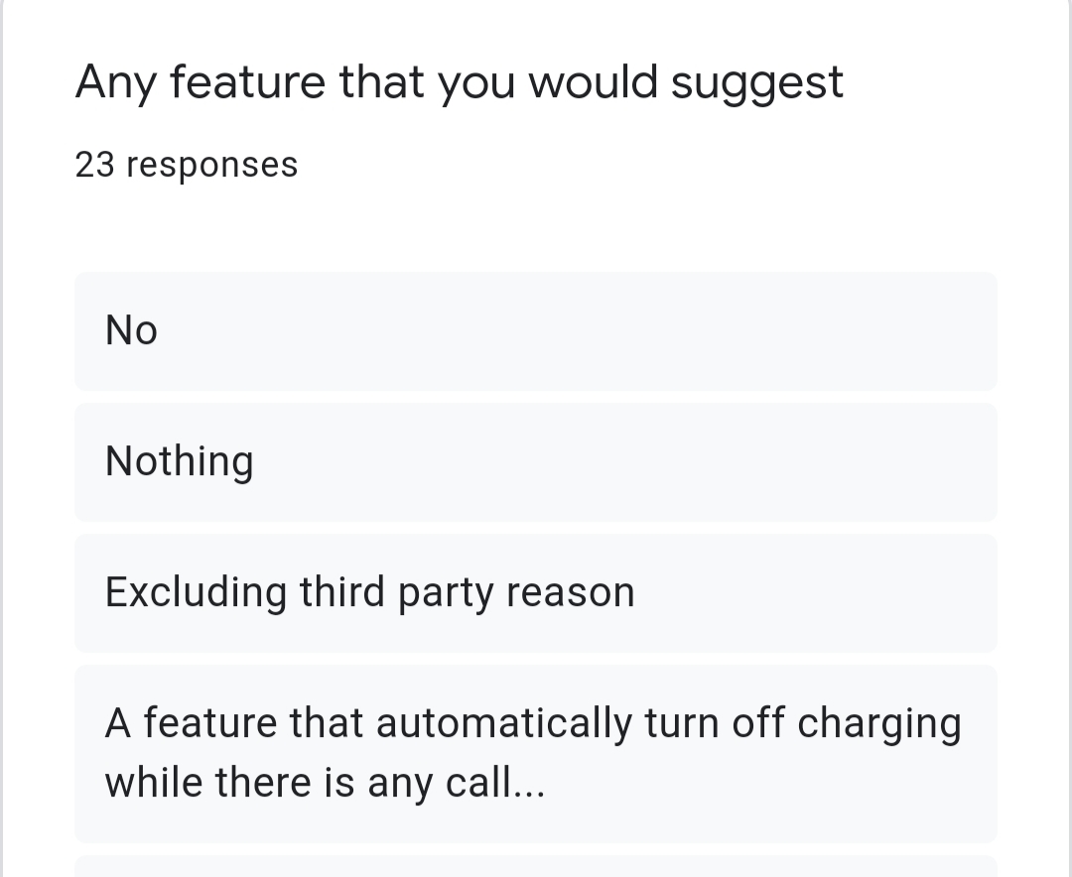
Any feature that you would suggest….

Slide 38
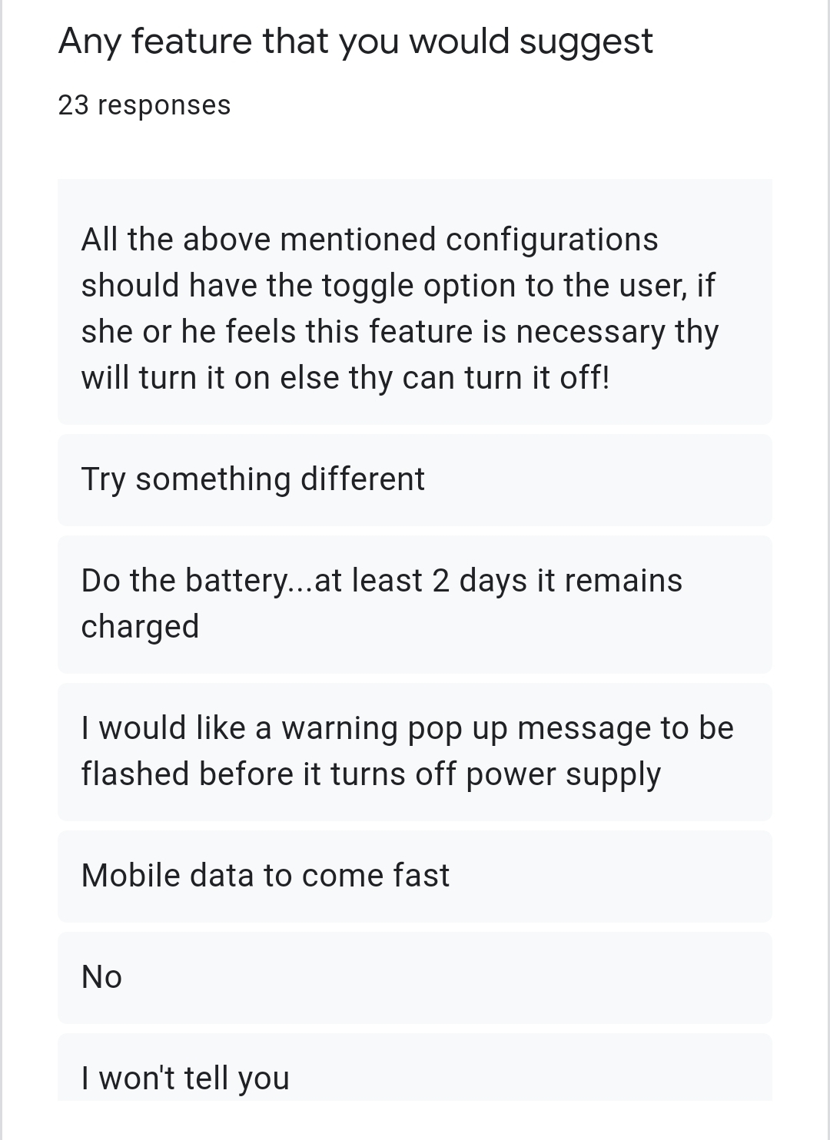
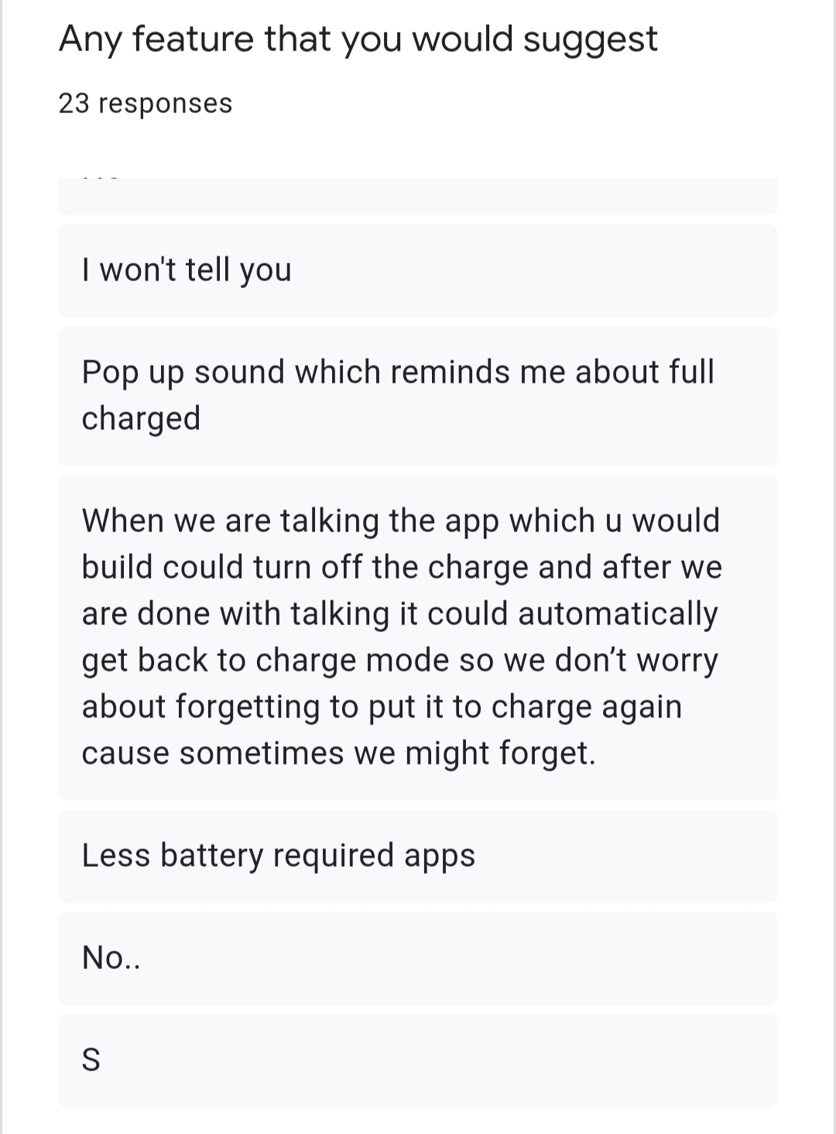

Slide 39
Summary of suggestions:
A feature that automatically turns off charging when there is a call
The mobile’s wifi or internet connection should turn off so that the charging process will be fast
Change from silent mode to normal mode to receive all notifications
All features must be in that toggle option
Before turning off power supply there should be a pop up message
Get back to charging after we are done with our work
Makes the other unwanted apps power consuming apps to sleep
Do something so that phone battery lasts for 2 days

Slide 40


This presentation helped us to….
-Developed team spirit among us
-Helped us to improvise our communication skills
-Helped us build more knowledge on our topic
-Helped us to know each other in a better way
We would like to thank Sir for giving us this opportunity

Slide 41

Conclusion
We have tried our level best to give a satisfying solution to the problem that we have chosen for our case study

Slide 42



Thank You

